Slide 1
Cool Abstract Syntax Tree(AST)
Abstract syntax tree is a concrete data structure we build while parsing
One C++ class per Cool programming construct (e.g., let, plus, dispatch, function definition, class definition), defined in cool-tree.h and cool-tree.cc
Objects of the class are nodes in the AST

Slide 2
Cool Abstract Syntax Tree(AST)
cool-tree.h and cool-tree.cc are automatically generated from cool-tree.aps
cool-tree.aps has a high-level description of tree structure.
by a utility that compiles the specification into C++ functions for producing and consuming the tree nodes.

Slide 3
cool-tree.aps
APS: A (typed) tree language for Cool abstract syntax trees
cool-tree.aps contains the definitions for the AST
The declarations of APS are compiled into C++ class declarations by an APS compiler.
APS Contains
Constructor
Phylum

Slide 4
cool-tree.aps
Constructor
Is one kind of AST node
With a lower case name
the function you use in cool.y to build the tree node
For example:

Slide 5
cool-tree.aps
Constructor
constructor assign(name : Symbol; expr : Expression) : Expression;
Each constructor corresponds to a portion of the cool grammar
constructor program(classes : Classes) : Program;
constructor class_(name : Symbol; parent: Symbol;
features : Features; filename : Symbol): Class_;

Slide 6
cool-tree.aps
Phylum
Categorization of a group of constructors, related to their role in the language
names start with upper case
Phyla are just types that group related constructors together

Slide 7
cool-tree.aps
Phylum
For example:
phylum Expression;
RHS of assignment operator can be any expression, so we categorize all expression node types as one phylum, Expression
phylum Program;
phylum Class_;

Slide 8
cool-tree.aps
Using APS notation (in cool-tree.aps) to generates the C function with prototype (in cool-tree.h)
For example:
constructor assign(name: Symbol, expr: Expression): Expression
Expression assign(Symbol name, Expression expr);
Creates an assign node from a name (LHS) and an expr (RHS), returns a pointer to the node (phylum type Expression)

Slide 9
Constructor body
What exactly does assign do?
Here’s the code from cool-tree.cc
Expression assign(Symbol name, Expression expr)
{
return new assign_class(name, expr);
}
C function wrapper which calls C++ constructor.
What are the types? . ..

Slide 10
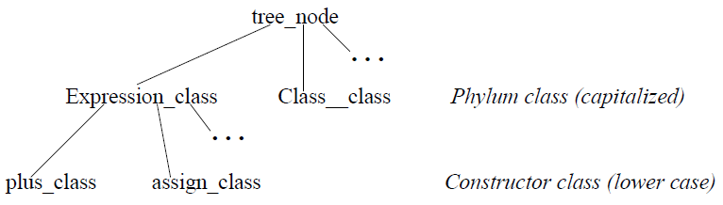
AST Classes
Types use a consistent naming scheme (automatically generated from .aps file)
phylum/constructor relationship implemented using inheritance
here’s the inheritance hierarchy:

Slide 11
AST Classes (cont.)
Phylum name is defined as follows:
typedef Expression_class * Expression;
since assign_class ISA Expression_class, can return
Expression from assign constructor:
Expression assign(Symbol name, Expression expr)
{
return new assign_class(name, expr);
}
using pointer to more general type enables us to substitute any specific expression node pointer (e.g., pointer to assign_class) where an Expression node pointer is expected.

Slide 12
AST Lists
Sometimes need a list of tree nodes as part of the AST. e.g.:
list of attributes in a class definition
list of classes in a program
list of actual parameters in a dispatch expression
Some phyla are list phyla: a list of tree nodes of that phylum

Slide 13
AST Lists
Example from cool-tree.aps:
phylum Expressions = LIST[Expression];
Example of the use of Expressions in a constructor:
Expression dispatch(Expression expr, Symbol name, Expressions actuals);

Slide 14
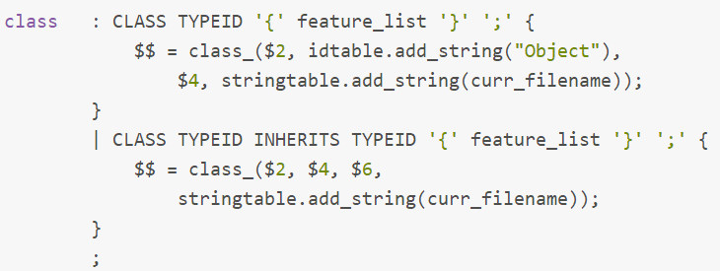
According to the definition of AST nodes in cool-tree.aps,
you can write parsing rules easily in cool.y.
For example, the definition of the constructor of class is as follows:
constructor class_(name : Symbol; parent: Symbol;
features : Features; filename : Symbol): Class_;
The parsing rule is as follows:

Slide 15
Discription of files
tree.{cc|h}(The definition of AST nodes)
cool-tree.aps (The APS definition of AST)
cool-tree. {cc|h}( (Generated by APS)
cool.y (Source code of parser)
cool.output (The report generated by yacc)
cool.tab.h (Generated by yacc)
cool-parse.cc is the generated C++ file containing the parser
dumptype.cc (prints the AST out)
utilities.cc (Other functions for output)

